Slide 1
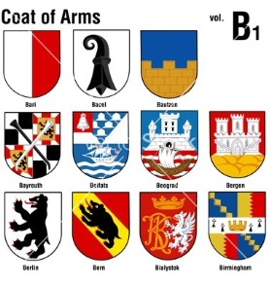
Heraldry
Examine the Heraldry Packet and the information on the back side of your shield.
Then, create your own shield.
Try to include at least two colors, one symbol, and one animal that represents you and your personality.
Be neat and creative!

Slide 2
Examples of Heraldry

Slide 3
Examples of Heraldry

