Slide 1
Medieval Life:

Slide 2
Europe around 400 AD (Roman Empire)

Slide 3
Europe around 500 (The Dark Ages)

Slide 4
After the Fall of Rome, Europe was scary!!

Slide 5
Europe was a Dangerous Place!!!
Slavs
Germanic Tribes

Slide 6
Europe was a Dangerous Place!!
Huns
Saxons

Slide 7
VIKINGS!!!!

Slide 8
Vikings!!!!

Slide 9
Vikings!!!!

Slide 10
Rome vs Dark Ages

Slide 11
Rome vs Dark Ages

Slide 12
Rome vs Dark Ages

Slide 13
Rome vs Dark Ages

Slide 14
Rome vs. Dark Ages

Slide 15
Rome vs Dark Ages

Slide 16
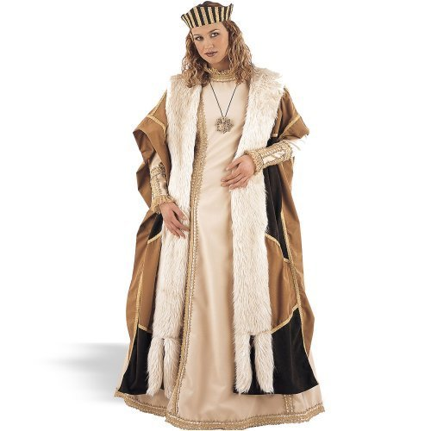
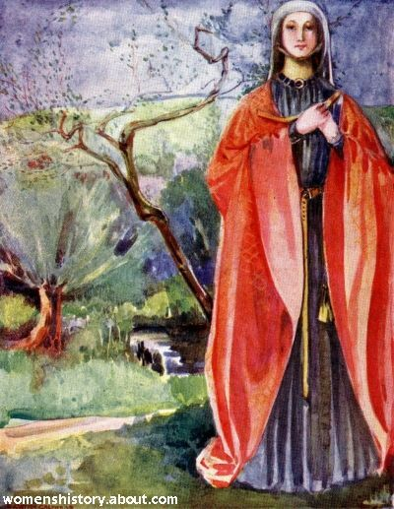
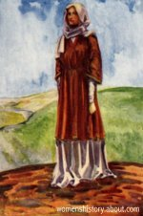
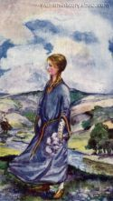
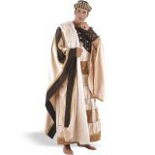
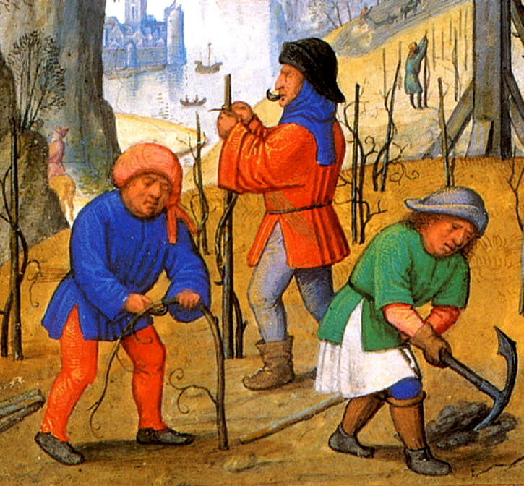
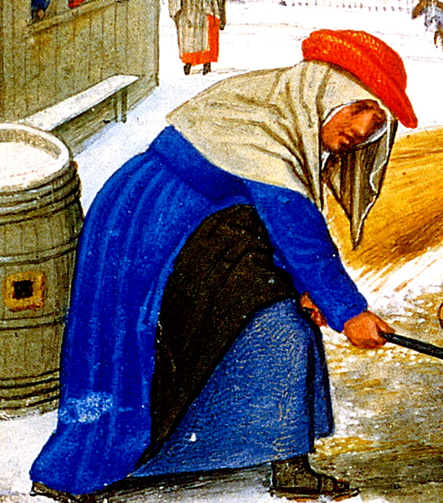

Slide 17
Medieval Names:
Male Names:
Female Names:
Percival Baldwin William Phillipe Harold
Tom Bertrand Charles Arthur Henri
Roderick Arnoul Leopold Roland Roger
Merton Michael George Francis Will
Wildred Leo Alan Gerbert John
Bartholomew Gregorgy Robert Odo
Raymond Richard Lorenzo Rollo
Abelard Oswald Edward Clovis Hugh
Culbert Geoffrey Lothaire Merlin Villard
Jack Peter Guido Otto Omar
Elizabeth Maud Ardeth Kathrine
Mary Tilly Gwen Anne Adele
Margaret Miriam Roslyn Bertha
Marian Isolte Matilda Yolande Emma
Ethelfled Ethel Ruth Martha
Agnes Ellen Waldrada Clare Aliena Theutberga

Slide 18
Lesson #2: Fuedalism & ME Names
-In the beginning of the middle ages, people didn’t have a huge need for surnames, or last names. However, as towns grew officials forced people to add a last name for taxation purposes. It was common to use someone’s hometown as a last name, their father’s first name, or a physical characteristic. How do you think the following men earned their last names?
1. Percival Miller 2. Alex de Hanover 3. Martin Short
-Females simply referred to themselves as the wife of their husband as it was not necessary for them to have a last name because they did not pay taxes. Ex. Julie, wife of Alex de Hanover or Julie, daughter of Alex de Hanover

Slide 19
Lesson #2: Fuedalism & ME Names
Here is a list of a few of the occupations held by medieval men:
Gamekeeper Miller Plowman Mason
Baker Woodcutter (Cutter) Singer Butcher
Marshal Stonemaker Watchman Clerk/Clark
King Cobbler (Shoe Maker) Wheelright Cartwright
Monk Parker (Kept Lord’s Park Up) Walker
Bowman Carpenter Fisher Smith
Hunter Knight Cook Yeoman Page
Squire Cooper (Barrel maker) Turner Weaver
Shields (Shield maker) Armour (Took care of) Queen Garrison

Slide 20
1.JOBS 2. SON OF… 3. NAME OF HOME TOWN 4. HOW YOU LOOKED
Jobs:
First Name:
Gamekeeper Miller Plowman Mason
Baker Woodcutter (Cutter) Singer
Butcher Marshal Stonemaker Watchman
Clerk/Clark King Cobbler (Shoe Maker)
Wheelright Cartwright Monk
Parker (Kept Lord’s Park Up) Walker
Bowman Carpenter Fisher Smith
Hunter Knight Cook Page Squire
Cooper (Barrel maker) Turner Weaver
Shields (Shield maker) Armour (Took care of)
Queen
Percival Baldwin William Phillipe Harold
Tom Bertrand Charles Arthur Henri
Roderick Arnoul Leopold Roland Roger
Merton Michael George Francis Will
Wildred Leo Alan Gerbert John
Bartholomew Gregorgy Robert Odo
Abelard Oswald Edward Clovis Hugh
Culbert Geoffrey Lothaire Merlin Villard
Jack Peter Guido Otto Omar

Slide 21
Medieval (Gothic) Architecture

Slide 22
Gothic Architecture

Slide 23
Gothic Architecture

Slide 24
Gothic Architecture

Slide 25
Notre Dame Cathedral (Paris)

Slide 26
Notre Dame

Slide 27
Notre Dame

Slide 28
Notre Dame

Slide 29
Gargoyles!

Slide 30
Gargoyles!

Slide 31
Gargoyles

Slide 32
Heraldry

Slide 33
Heraldry

