Slide 1
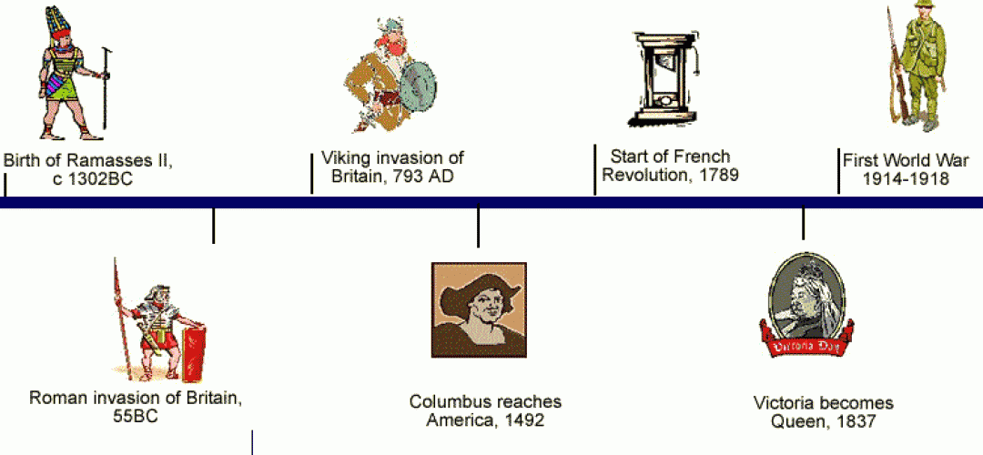
Timeline Review
Which event occurred most recently?
Which event occurred roughly seven centuries before the Viking invasion of Britain?
Which event occurred first: Birth of Ramasses or Roman invasion of Britain?
About how many centuries are between Columbus reaching America and the Start of the French Revolution?

