Slide 1
Latitude and Longitude!!!

Slide 2
Latitude!!
1.) Always measured in North or South
2.) If above the Equator, its North
3.) If below the Equator, its South

Slide 3
Latitude
10⁰N
0⁰ Motzieville
Motzieland
10⁰S

Slide 4
Latitude
10⁰N
Motzieville
0 ⁰

Slide 5
Latitude
20⁰ N
Motzieville
10⁰ N

Slide 6
Latitude
0⁰
Motzieville
10 ⁰S

Slide 7
Latitude
20⁰S
Motzieville
30 ⁰S

Slide 8
Longitude
1.) Always measured East or West
2.) If West (left) of Prime Meridian, its West
3.) If East (right) of Prime Meridian, its East

Slide 9
Longitude:
10⁰W 0⁰ 10⁰E

Slide 10
Longitude:
10⁰W 0⁰

Slide 11
Longitude:
0⁰ 10⁰ E

Slide 12
Longitude:
20⁰W 10⁰W

Slide 13
Longitude:
20⁰E 30⁰E

Slide 14
Absolute Location!!
1.) Write the Latitude first and Longitude second!
2.) If you are one degree off, you are okay
If you are two degrees off, its okay but go back and try again
If you are three degrees off, I throw my shoe at you and never speak to you again! ☹

Slide 15
Absolute Location:
0⁰ 10⁰E
10⁰N
0⁰

Slide 16
Absolute Location:
10⁰W 0⁰
20⁰N
10⁰N

Slide 17
Absolute Location:
20⁰W 10⁰W
0⁰
10⁰S

Slide 18
Absolute Location:
20⁰W 10⁰W
30⁰N
20⁰N

Slide 19
Absolute Location:
0⁰ 10⁰E
10⁰N
0⁰

Slide 20
Absolute Location:
10⁰E 20⁰E
10⁰S
20⁰S

Slide 21
Absolute Location Review:
10⁰W 0⁰ 10⁰E
10⁰N A
B
E
0⁰
C
10⁰S D

Slide 22
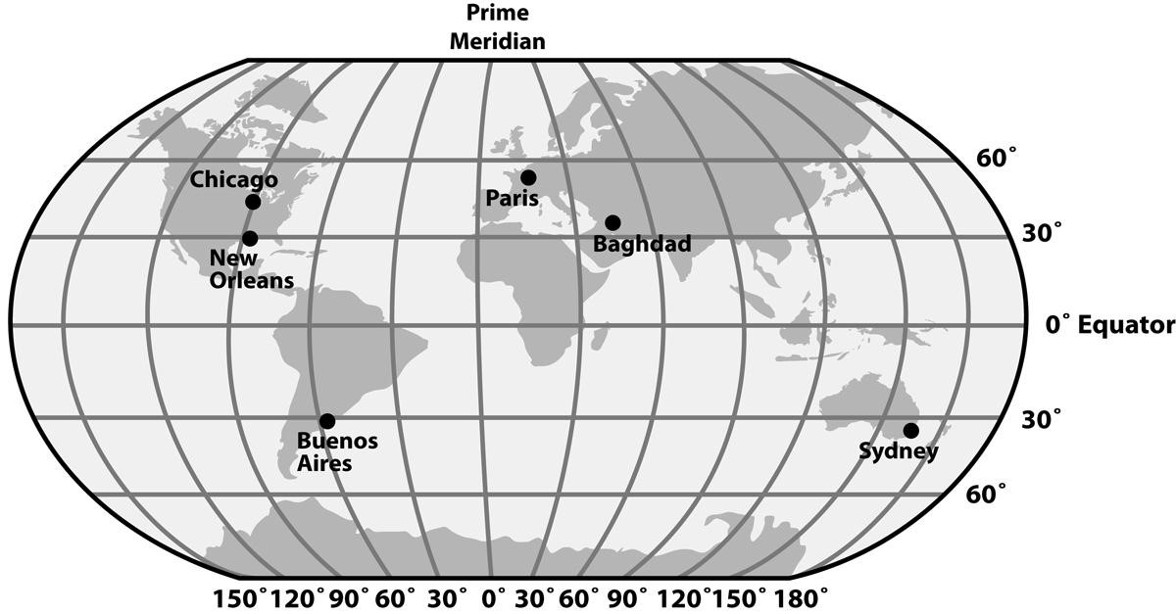
Practice Finding the Absolute Location!
Name the city at:
1.) 31 South, 58 West
2.) 35 South, 165 East
3.) 30 North, 88 West
4.) What is the absolute location for Paris, France?
5.) What is the absolute location for Baghdad?

Slide 23
Answers:
1.) Buenos Aires, Argentina
2.) Sydney, Australia
3.) New Orleans, LA
4.) Paris: 48 north, 2 east
5.) Baghdad: 33 north, 44 east

