Slide 1
Review
Which government gives citizens the most rights?
Which government gives citizens the least amount of rights?

Slide 2
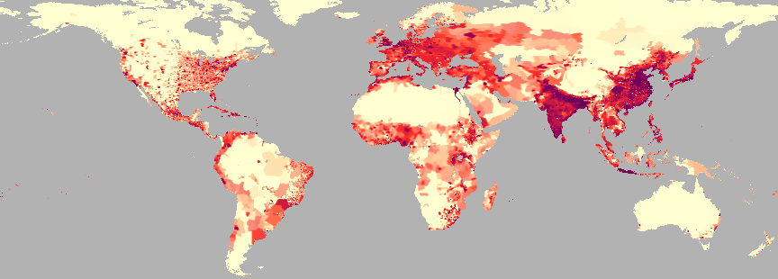
Review: Population Density

Slide 3
Globalization: Good or Bad?

Slide 4
Globalization
https://www.youtube.com/watch?v=newRbaPkkao

Slide 5
GDP
Gross Domestic Product (GDP):
Value of all goods and services produced in a country in a given year.
https://www.cia.gov/library/publications/the-world-factbook/rankorder/2001rank.html
GDP Per Capita: Total value of goods and services in a country divided by the total population
https://www.cia.gov/library/publications/the-world-factbook/rankorder/2004rank.html

Slide 6
Developed/Developing
Developed country:
High GDP Per Capita, high education or literacy rate, high life expectancy
Developing Country:
Low GDP Per Capita, low education or literacy rate, low life expectancy

