Slide 1
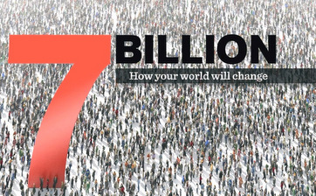
7 billion people in the world!!

Slide 2
World Population by country:
2015:
What 10 countries have the largest population in the world?
http://www.census.gov/popclock/
http://www.geoba.se/population.php?pc=world

Slide 3
7 billion people in the world!!
http://youtu.be/sc4HxPxNrZ0 (7 billion people)
http://www.youtube.com/watch?v=4B2xOvKFFz4 (worlds most typical person)

Slide 4
Worlds Most Average/Typical Person?
Male or Female?
Age?
Race/Ethnicity?
How much $$ do they make per year?
Left or Right handed?
Cell Phone or no Cell Phone?

Slide 5
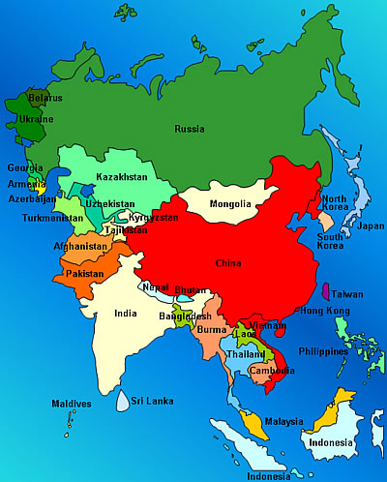
7 billion people in the world!

Slide 6
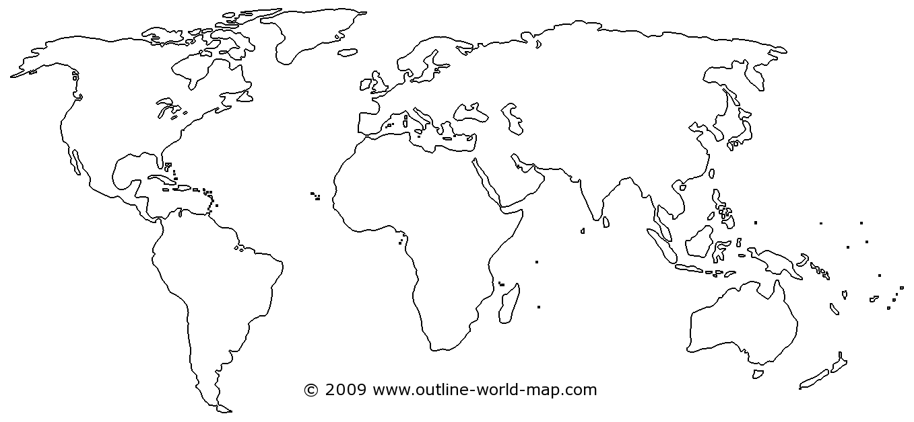
7 billion people in the world

Slide 7
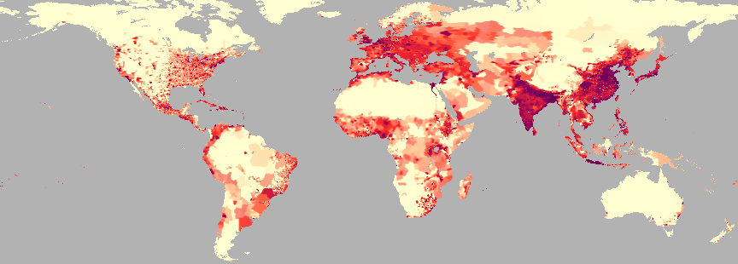
Population Density: measure of the number of people per unit of land

Slide 8
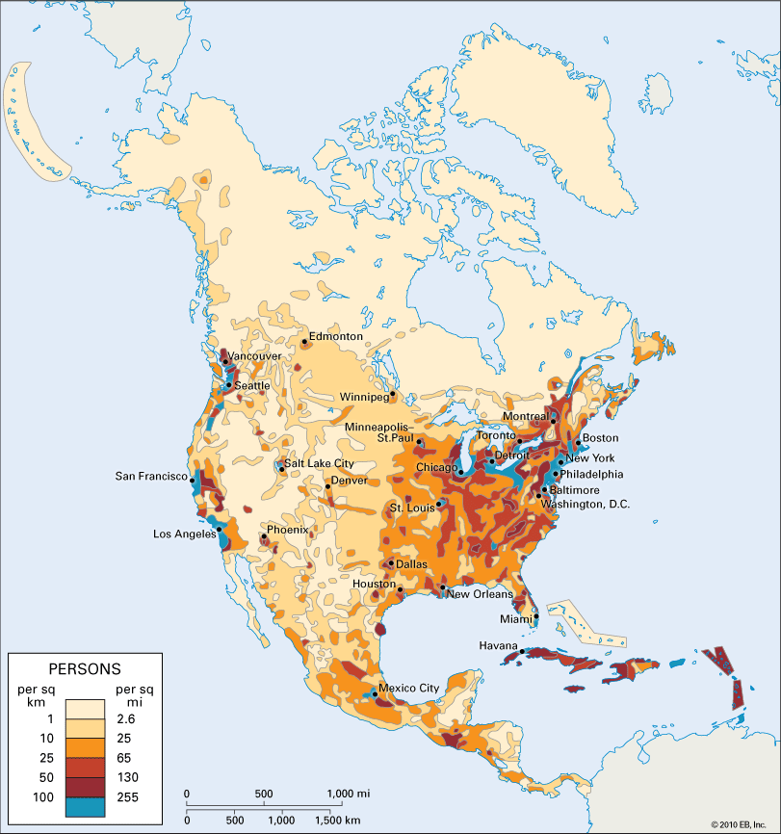
America today: About how many people lived in the area the red and yellow arrows are pointing to?

Slide 9
Why??
Why don’t people spread out? Why do we live so close together?
Any solutions on how to reduce our DENSE population?
Read pg. 74-79

